Slide 1


Group of Legends Final Project
PREDICTING GAME OUTCOMES
BUA-600 Python for Business
Karen Jolley
Renata Martins
Stephen Skeels
Juan Ventosa
Adam Vuolo

Slide 2
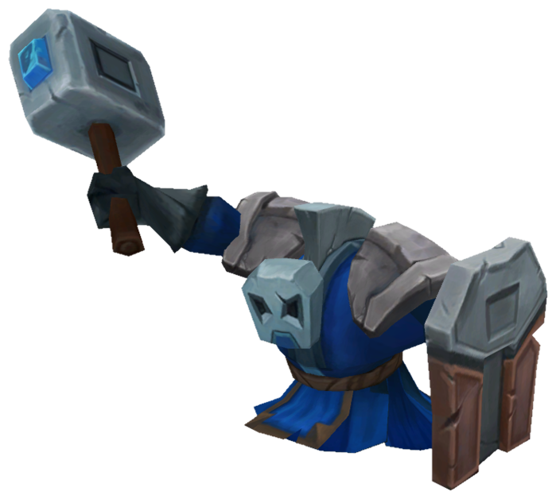
Motivation and Problem Statement:
Predicting Online Game Outcomes are of interest to many audiences
Game Developers
Game Players
Online Gaming Audience
Game Developers can better balance gameplay by improving areas vulnerable to manipulation and exploitation.
Game Players can gain strategic insights on activities to increase their odds of winning.
Online Gaming Audience can better evaluate how well the teams are performing.
BLUE MINION

Slide 3
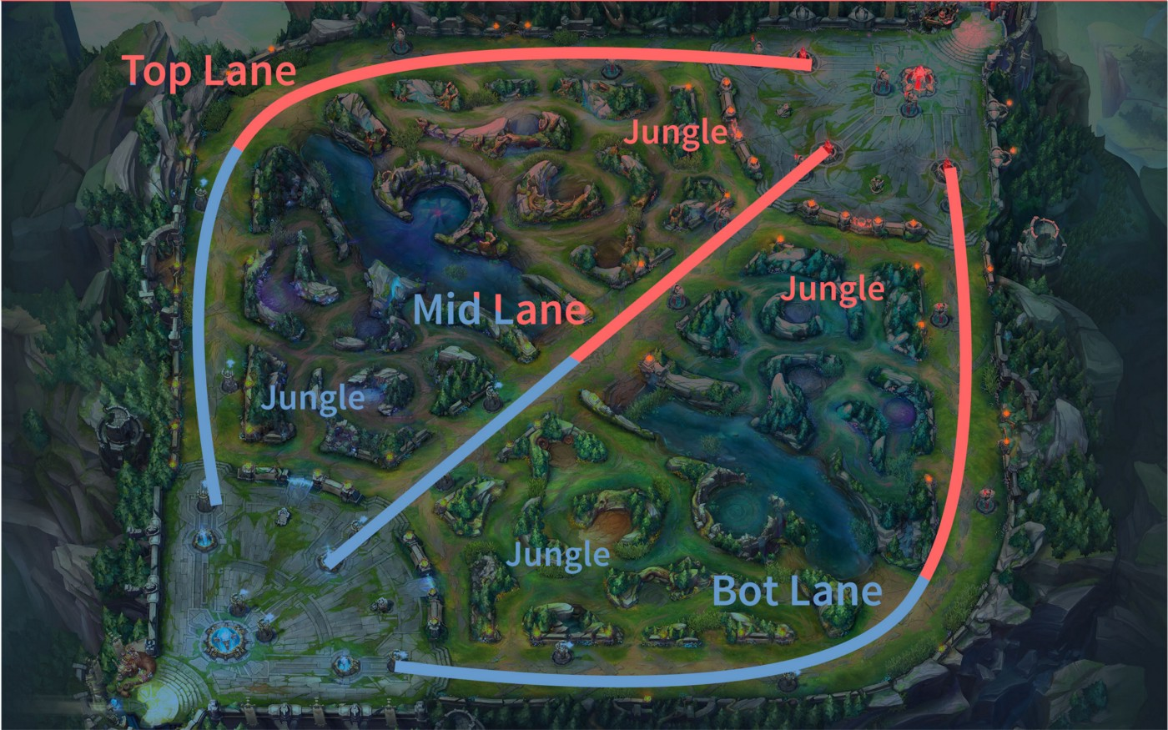
About League of Legends
League of Legends is a multiplayer online battle arena (MOBA) game developed by Riot Games.
2 groups of five players are placed into a “Blue” or “Red” team.
To win the game the two teams face off with the objective of being the first to destroy the other team’s home base or Nexus.
Each match length averages 45-60 minutes long and wins increase a player's rank.
Player rankings have 9 levels: Iron, Bronze, Silver, Gold, Platinum, Diamond, Master, Grand Master and Challenger

Slide 4

About the Data
Data Source: League of Legends Diamond Ranked Games (10 min) https://www.kaggle.com/bobbyscience/league-of-legends-diamond-ranked-games-10-min.
9,879 records with each record representing a unique match.
No null or missing values.
Data set contains only integer and float data types.
All players in the data are ranked in the Diamond to Master level.
Data set contains the statistics from both teams (blue and red) taken at the 10-minute mark of a match.
Each row is uniquely identified by a “gameID” with 19 features per team (38 in total) and a "blueWins" column where a value of 1 means the blue team has won; 0 otherwise.
RED MINION

Slide 5
Variables within the Data Set
The data set includes 40 attributes across 9,879 observations (19 variables are repeated for each team)
gameID Number ID of each unique match | Wins Binary: 1 = Blue Team Wins; 0 otherwise | Wards Placed Number of guard totems posted to spy an area | Wards Destroyed Number of enemy guard totems destroyed | First Blood Binary: 1= First kill of the game; 0 otherwise | Kills Number of enemy players killed | Deaths Number of team players killed by opponent
Assists Number of kills aided by a team member | Elite Monsters Number of monsters killed for bonus stats | Dragons Number of Dragons killed for bonus stats | Heralds Number of Heralds killed for bonus stats | Towers Destroyed Number of enemy structures destroyed | Total Gold Amount of gold collected from kills and destruction | Avg. Level Mean of all players’ level achieved during game (1 to 18)
Experience Sum of team players’ experience stats | Minions Enemy non-playable characters killed | Jungle Minions Independent non-playable characters killed | Gold Diff Difference in amount of gold between the two teams | Experience Diff Difference in sum of team players’ experience between the two teams | CS Per Min Creep score measures how well teams are performing minion kills per minute | Gold Per Min Amount of gold a team collects per minute
GOLD

Slide 6

Hypothesis and Objective:
Hypothesis:
The win-loss outcome of a League of Legends game among level Diamond and Master ranked players can be predicted based on key performance indicators at the 10-minute mark of a match.
Objectives:
Use Descriptive Statistics and Charts to explore and gain insights from the data
Use Predictive Machine Learning Models to predict win/loss game outcomes based on team stats at the 10 minute mark of a match.
Success:
Analysis will be considered a success if a predictive model has a greater than 70% accuracy for predicting the win/loss outcome of a match.
GROMP MONSTER

Slide 7

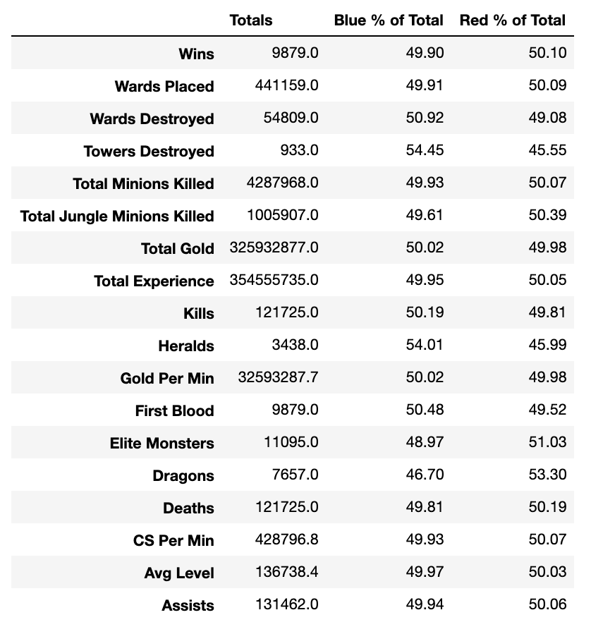
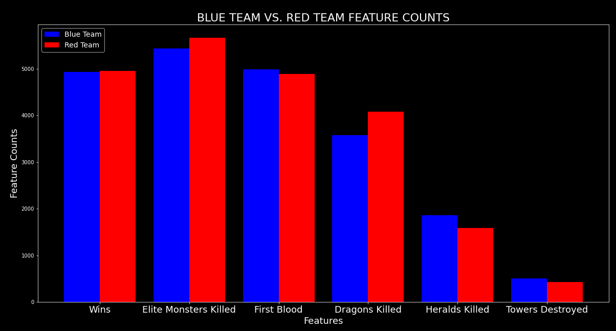
Descriptive Statistics: Feature Counts
The data set provides a collection of a nearly 50/50 split between Blue and Red team stats
HERALD

Slide 8

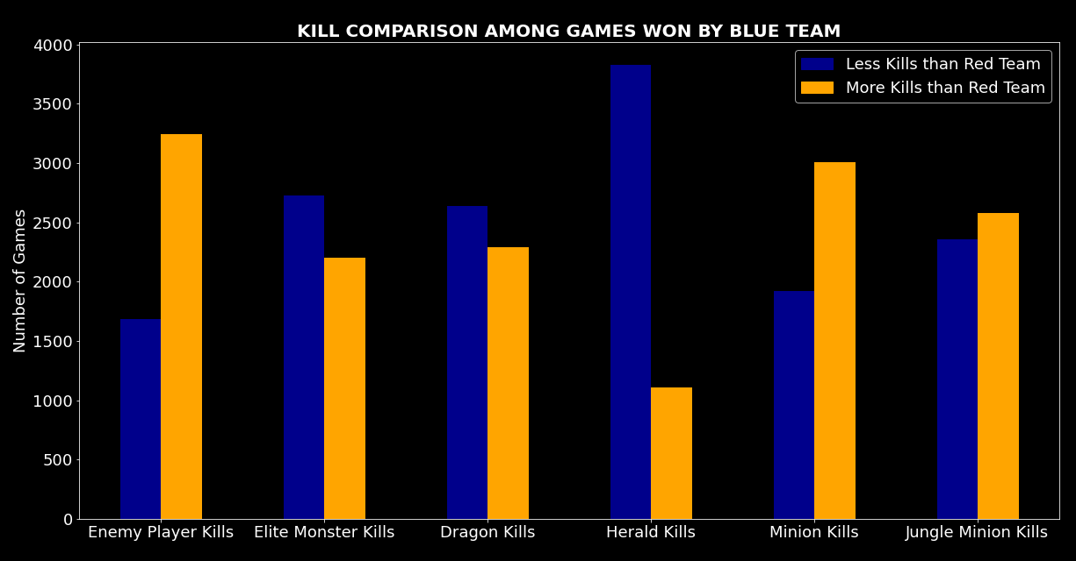
Blue Team Won: Kill Comparison at 10 Minute Mark
MURK WOLF MONSTER
Having more Kills than opponent does not guarantee a win.
More Enemy Kills, Minion Kills and Jungle Minion Kills appear to give an edge towards a win.
More Elite Monster, Dragon and Herald Kills appear to have less impact towards a win.
Blue Team won 4,930 games in the data set

Slide 9
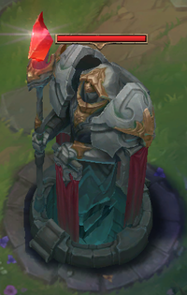
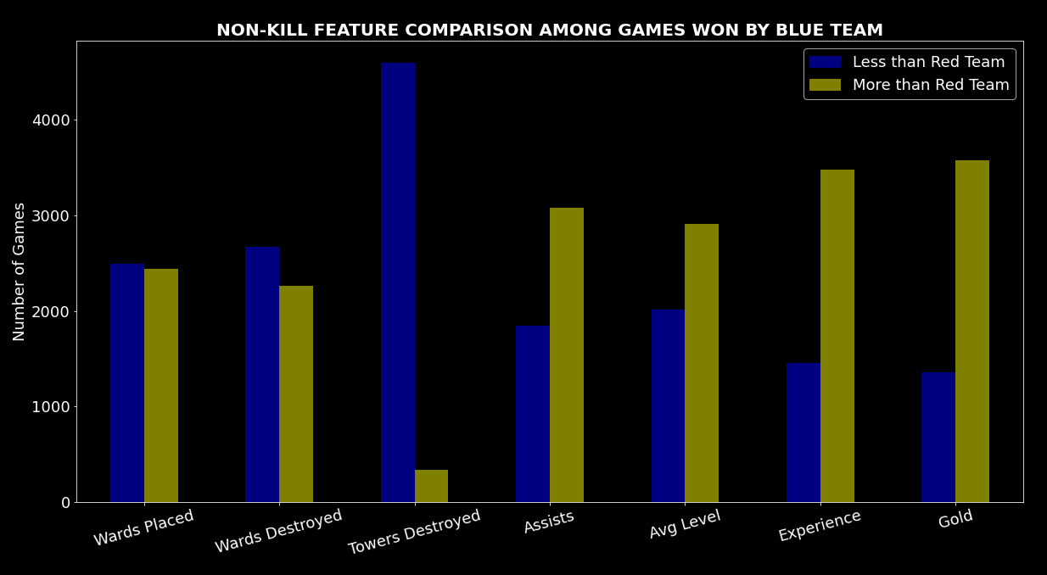
Blue Team Won: Non-Kill Comparison at 10 Minute Mark
TOWER
Having more items collected or destroyed does not guarantee a win.
More Assists, Gold, Experience and higher Avg. Level appear to give an advantage towards a win.
More Towers Destroyed, Wards Destroyed and Wards Placed appear to have less impact towards a win.
Blue Team won 4,930 games in the data set

Slide 10
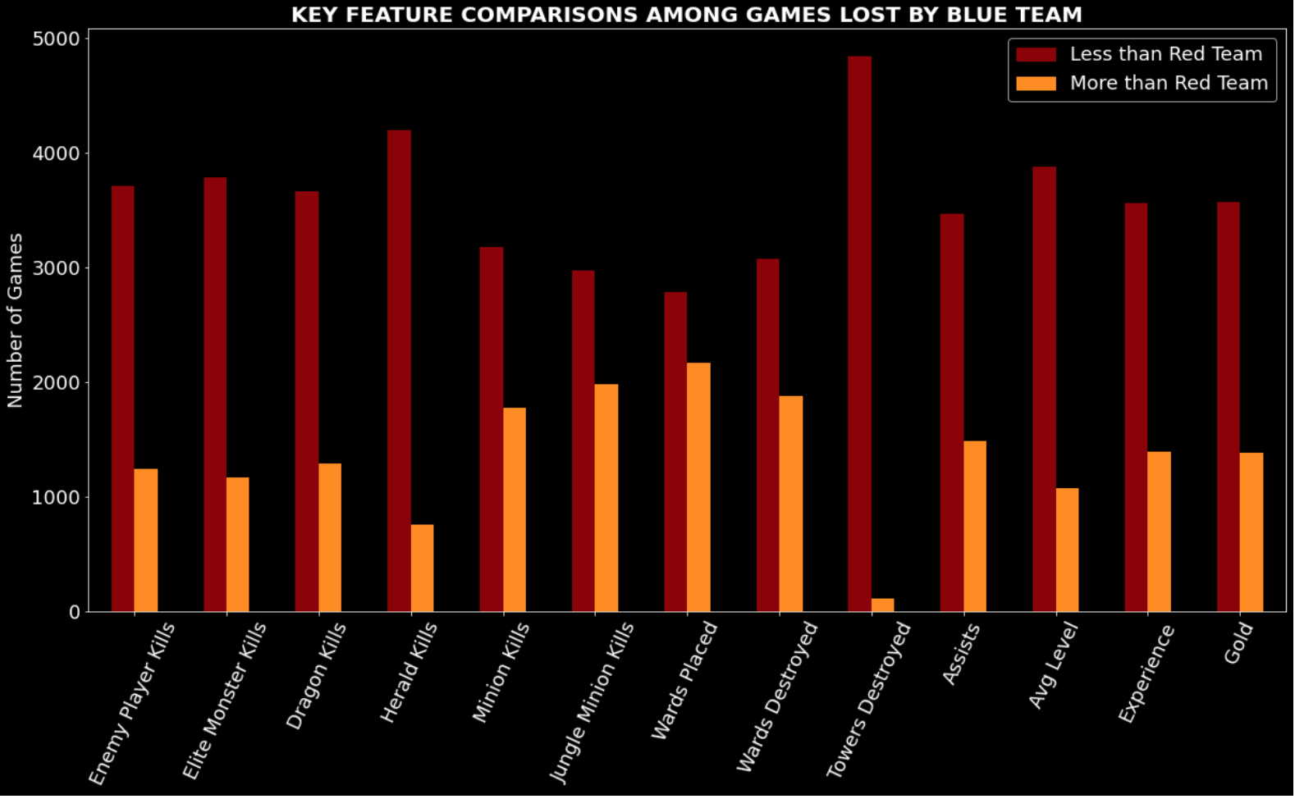
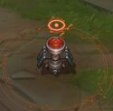
Blue Team Lost: Comparisons at 10 Minute Mark
Although performing less activities than the opponent team does not guarantee a loss, having less kills, less items destroyed and less items collected at the 10-minute mark of the game infers a higher likelihood of losing the match.
WARD
Blue Team lost 4,949 games in the data set

Slide 11
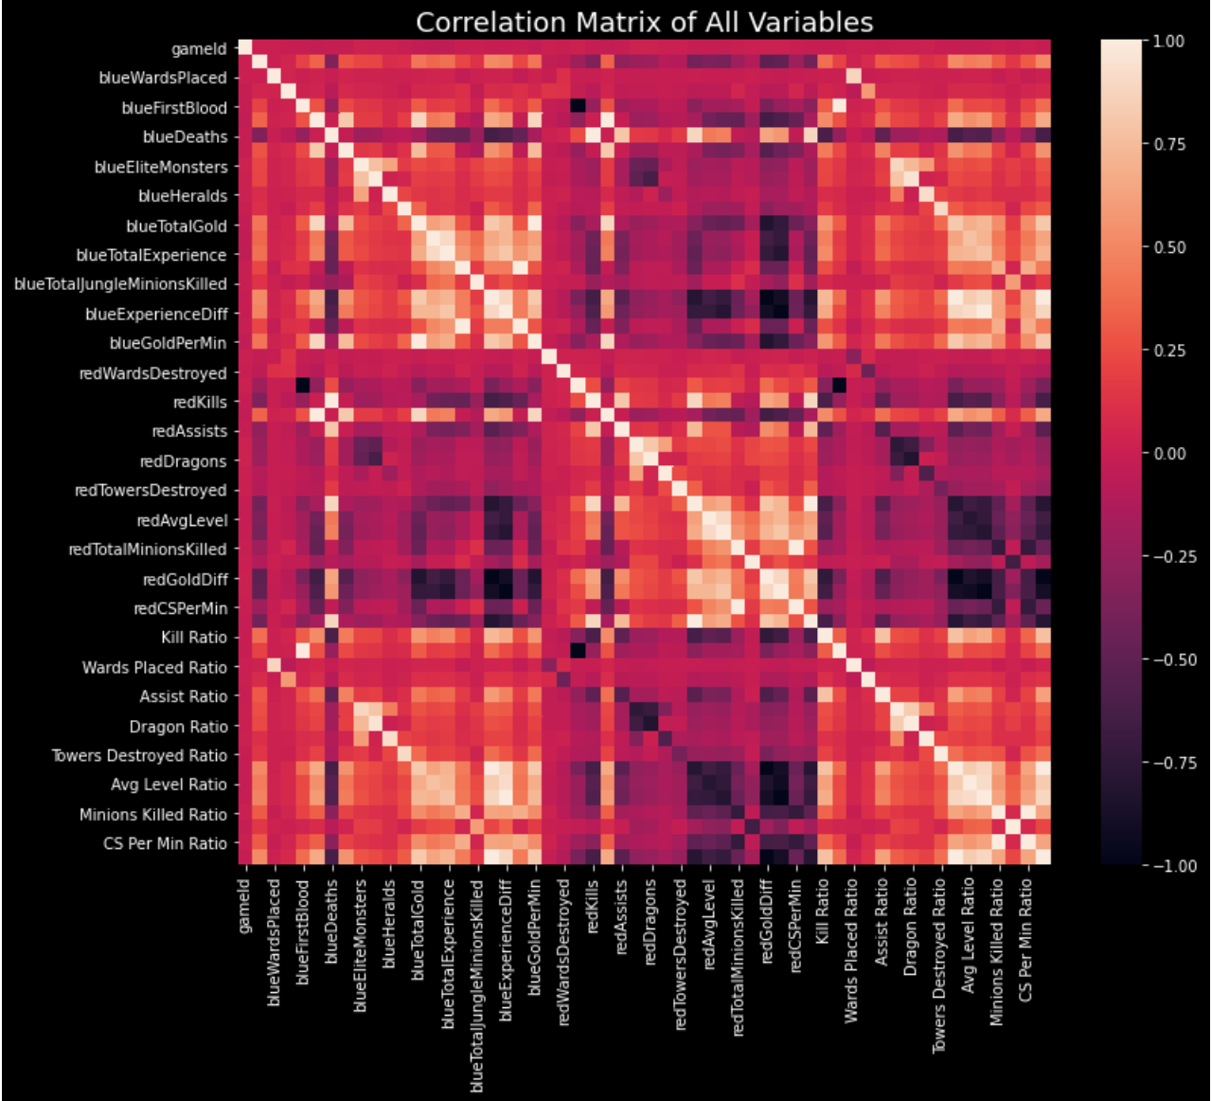
Correlation Matrix
As expected the data set contains many variables that are strongly correlated since many blue team and red team stats are related. Examples include:
Blue Kills and Red Deaths
Blue First Blood and Red First Blood
Blue Gold Diff and Red Gold Diff
Blue Experience. Diff and Red Experience. Diff
Some predictive models ideally require independent variables to have weak or no correlation. Two possible solutions to reduce strongly correlated variables are:
Drop one the correlated variables.
Combine the correlated variables

Slide 12
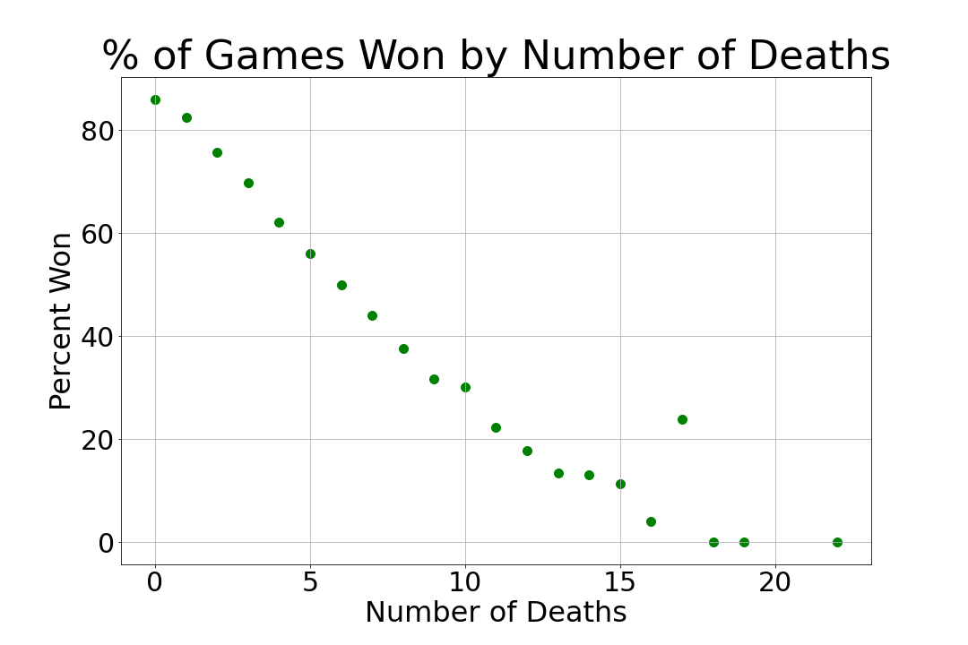
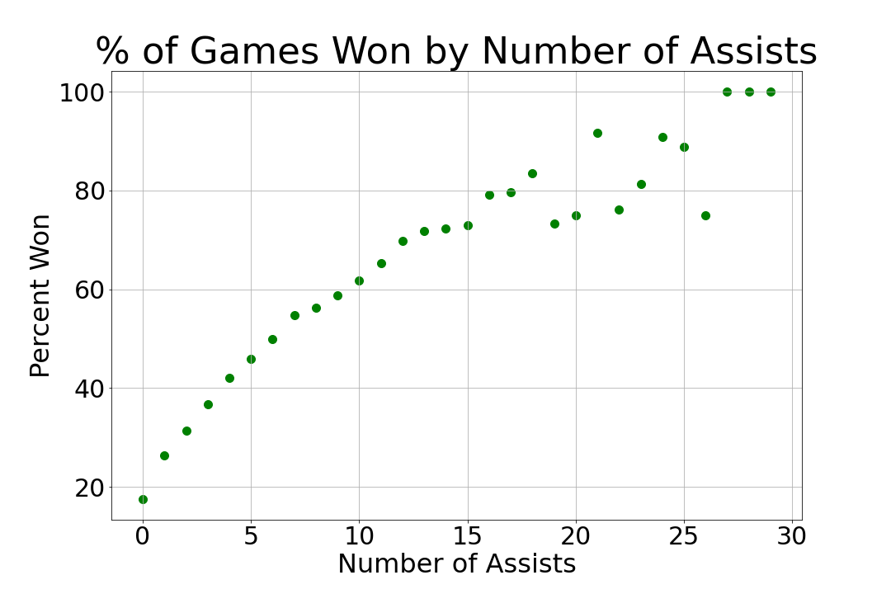
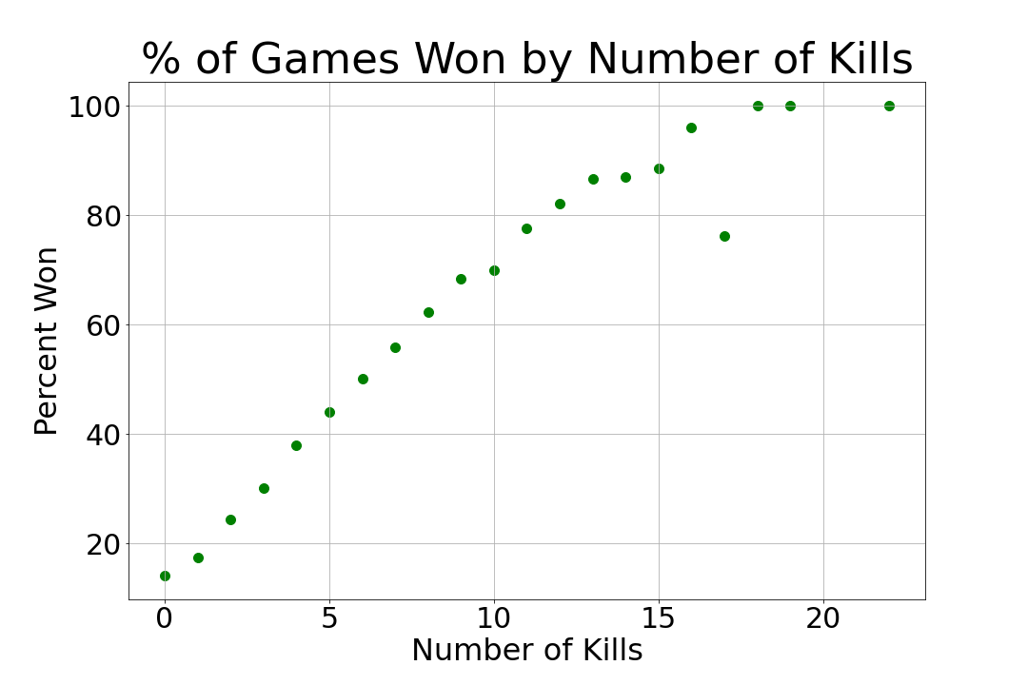
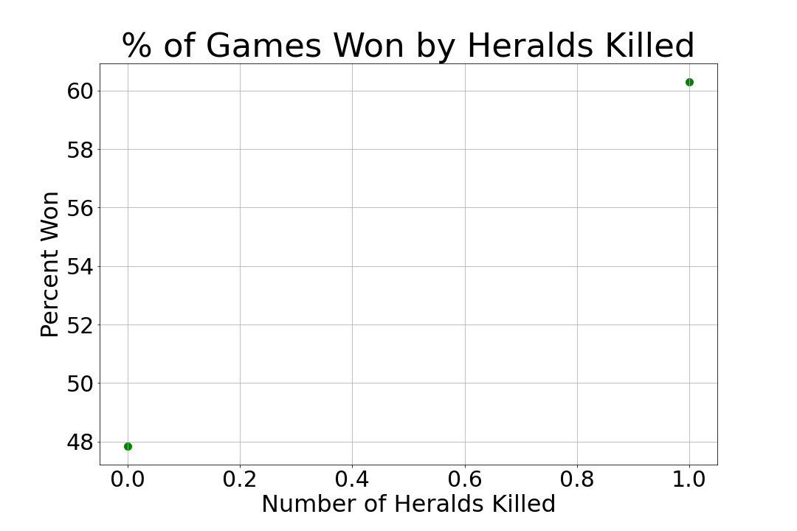
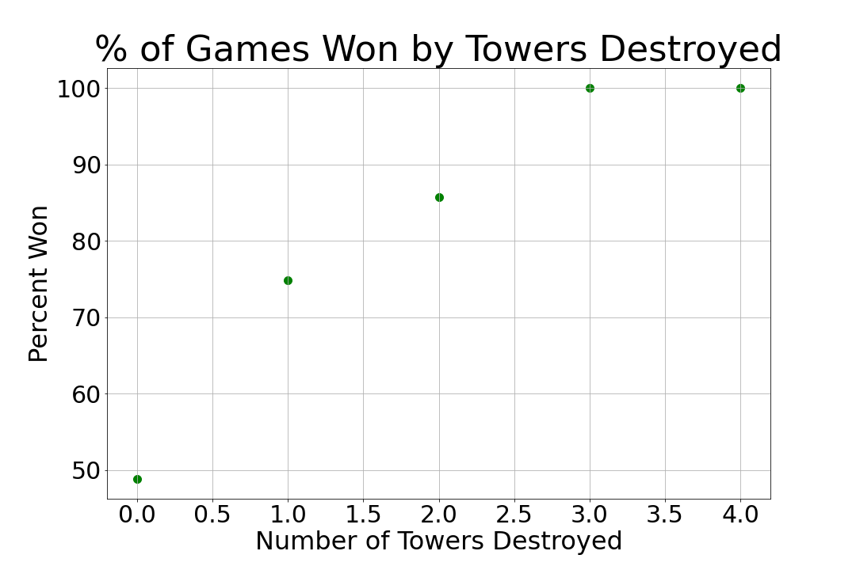
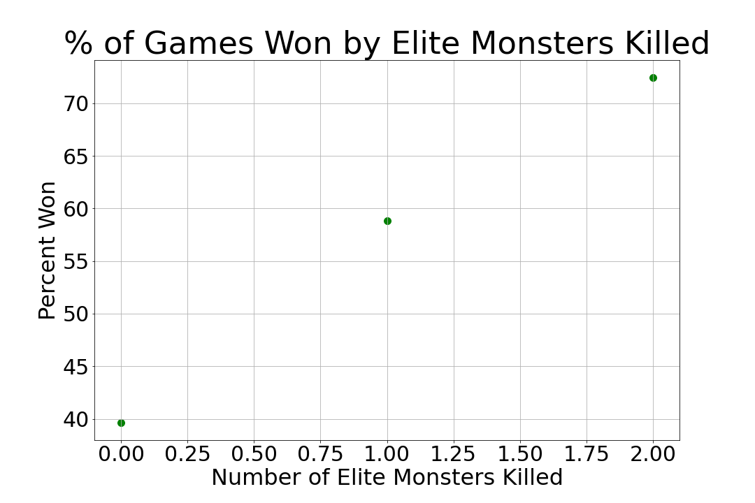
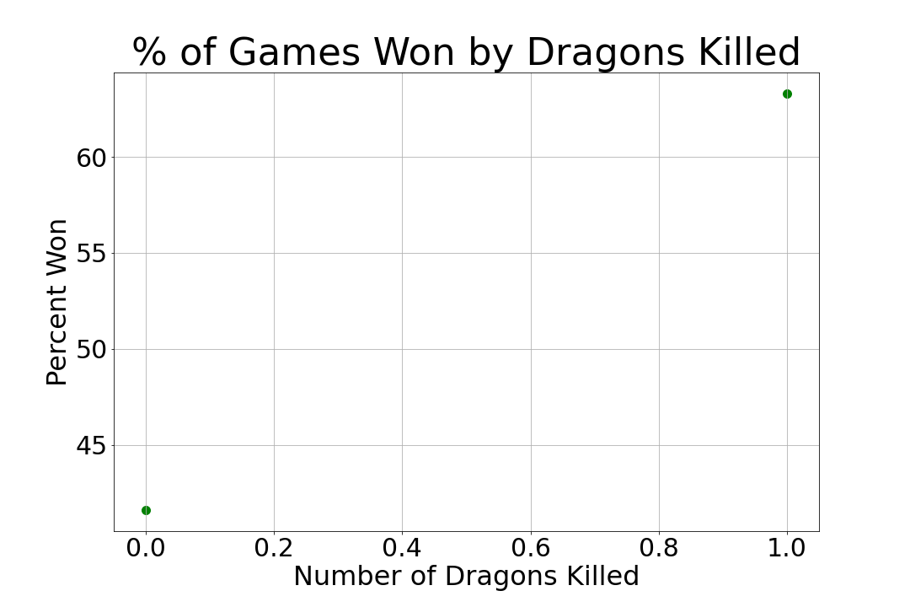
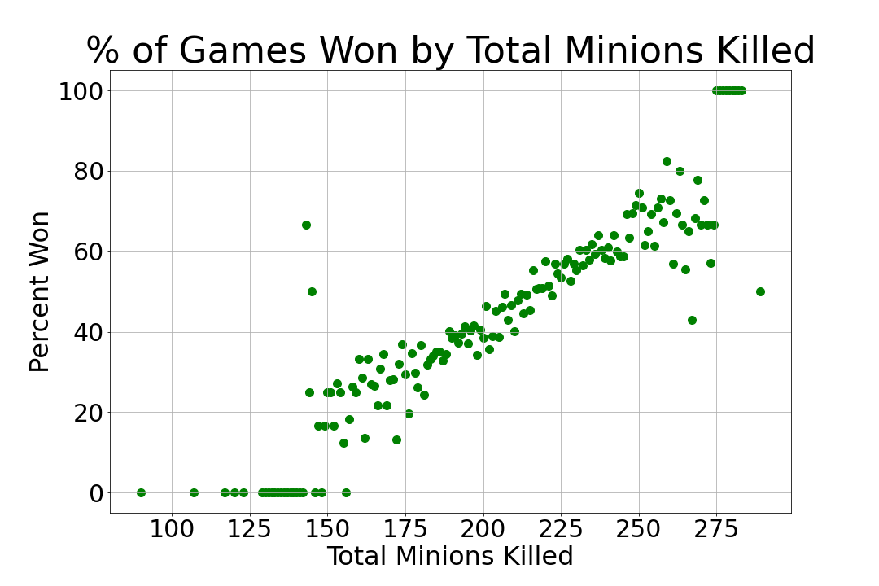
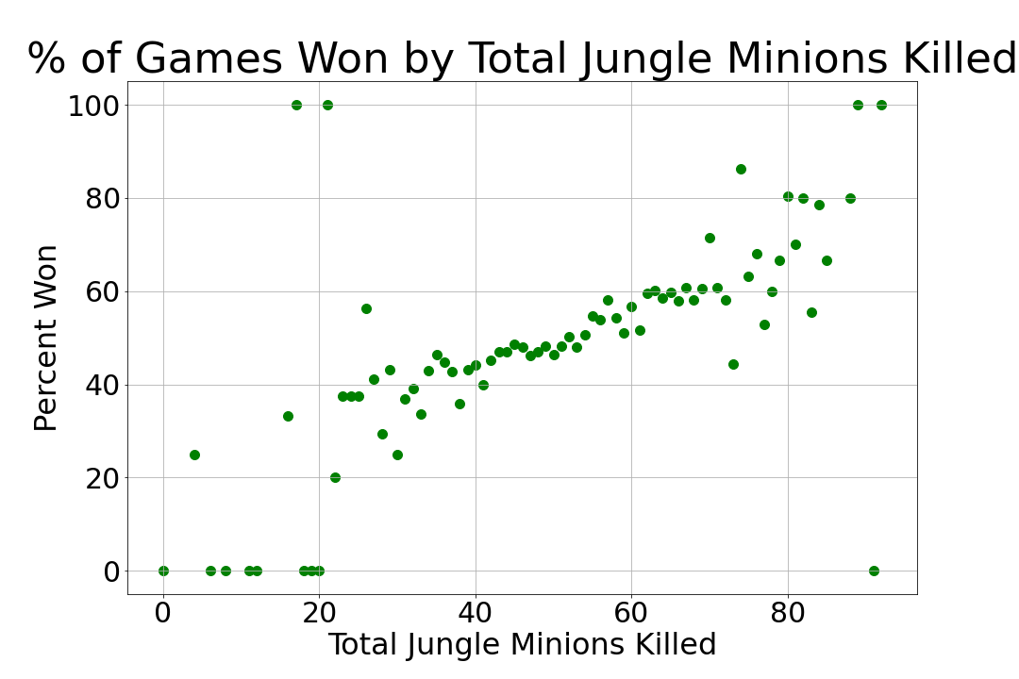
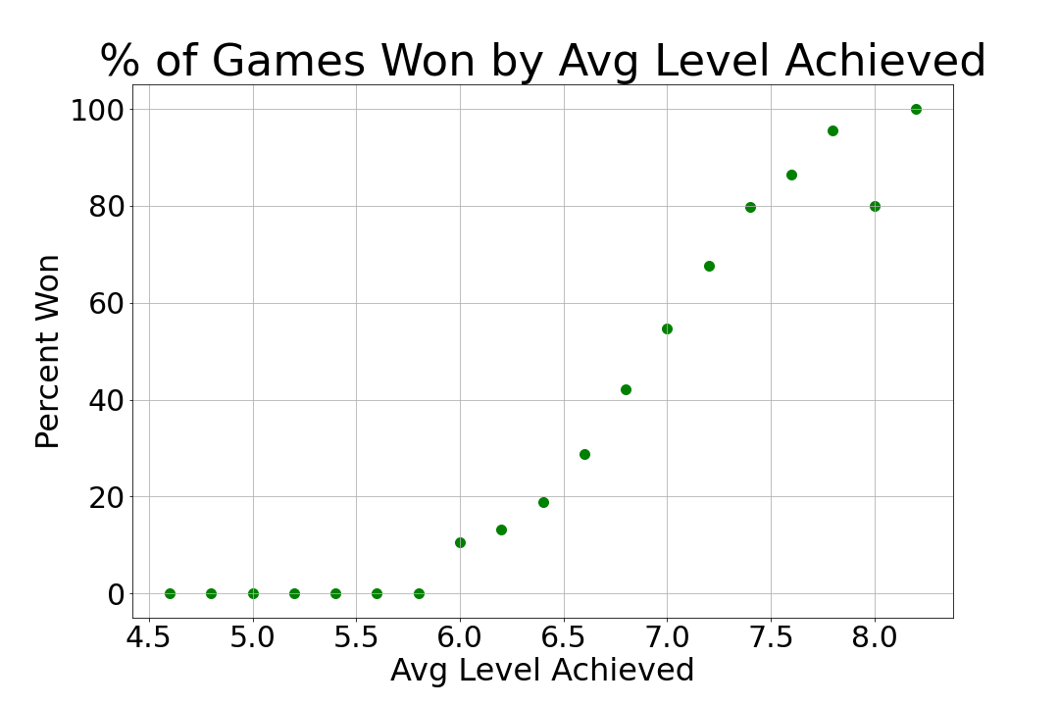
Correlation Using Percent of Games Won
These 10 features were chosen as the independent variables for the binary logistic regression models 1 and 2 based on their linear relation to the percent of games won.
Percent of games won was calculated by count of games won by feature value divided by total games by feature value. ​

Slide 13

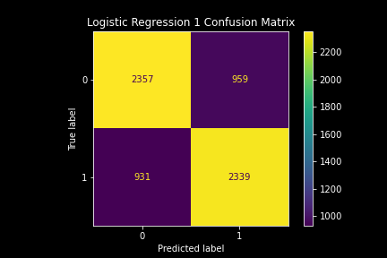
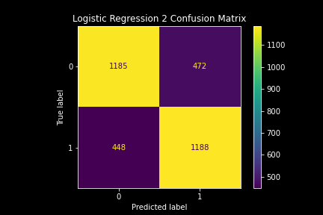
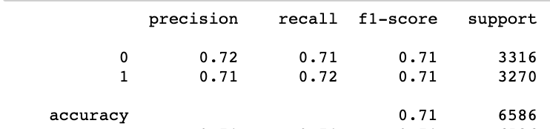
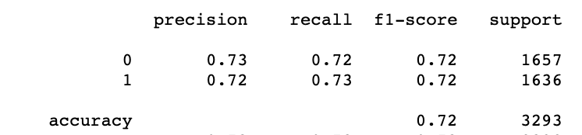
Logistic Regression Models to Predict Wins
Model 1: Single Team Stats
Accuracy = 71%
Model 2: Difference between Blue and Red Team Stats
Accuracy = 72%
Y / Predicted
1 = Won
0 = Lost
Data Split
Train: 67%
Test: 33%
Accuracy measurements based on model prediction of test data.
CHAMPION

Slide 14
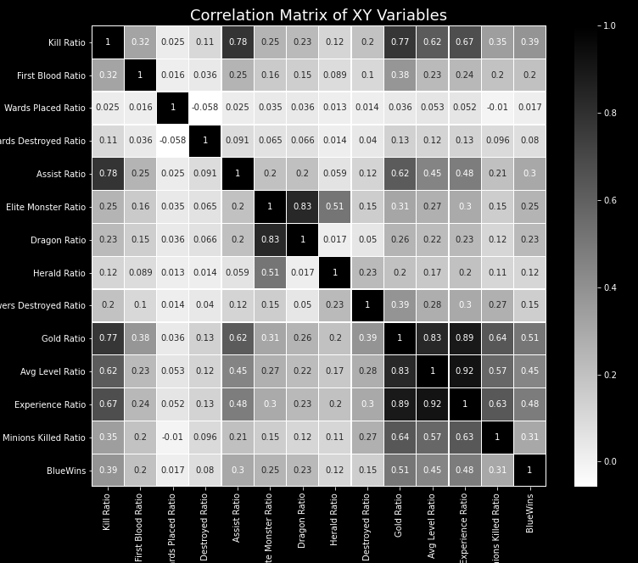
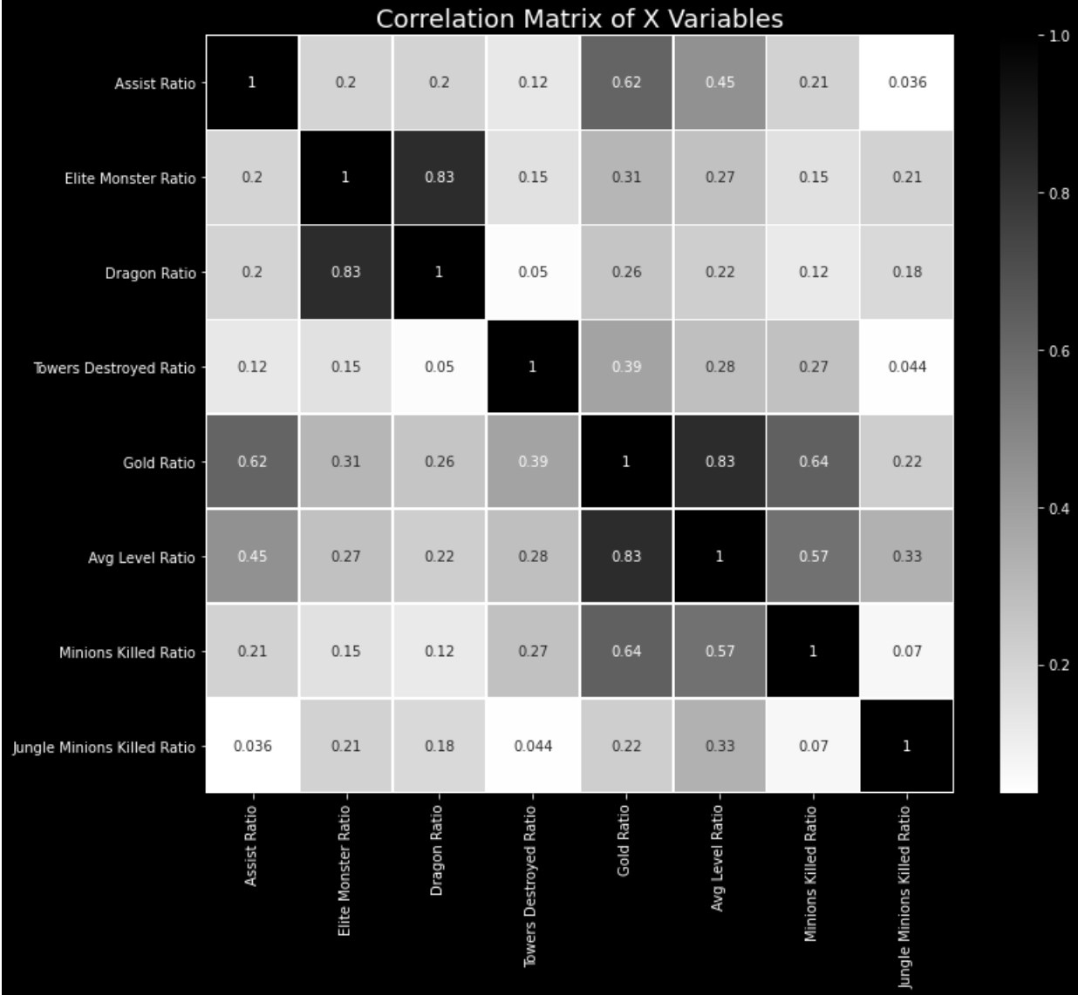
Using Blue Team/Red Team Ratios
Further Trimming of correlated variables required
Final 8 X-Variables Used to Train Logistic Regression Model 3

Slide 15
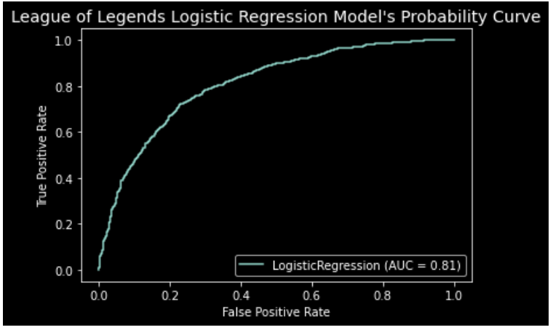
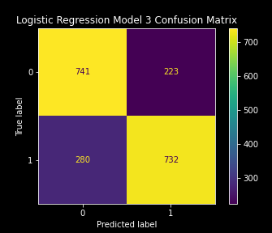
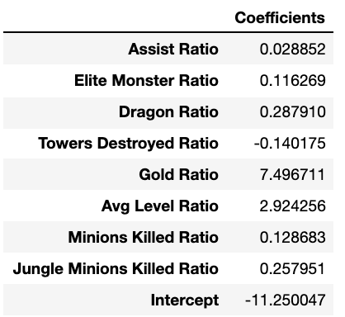
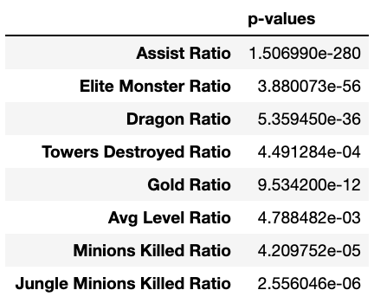
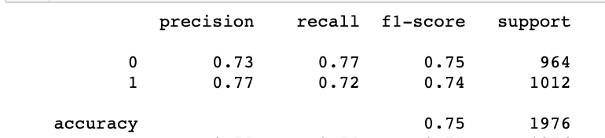
Logistic Regression 3 to Predict Blue Team Wins
Overall Accuracy: 75%
Y / Predicted
1= Blue Won
0 = Blue Lost
Data Split
Train: 80%
Test: 20%
Accuracy measurements based on model prediction of test data.

Slide 16

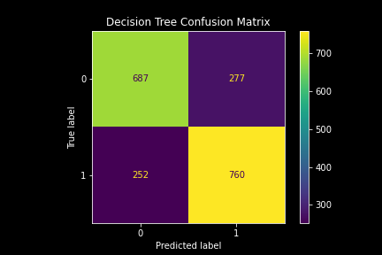
Decision Tree Classification
Overall Accuracy: 73%
DRAGON
Y / Predicted
1= Blue Won
0 = Blue Lost
Data Split
Train: 80%
Test: 20%
Prune
Max Leaf Nodes
20
Accuracy measurements based on
model prediction of test data.
 | Precision | Recall | F1-Score | Support
0 | 0.73 | 0.71 | 0.72 | 964
1 | 0.73 | 0.75 | 0.74 | 1012
 |  | Accuracy : | 0.73 | 1976

Slide 17
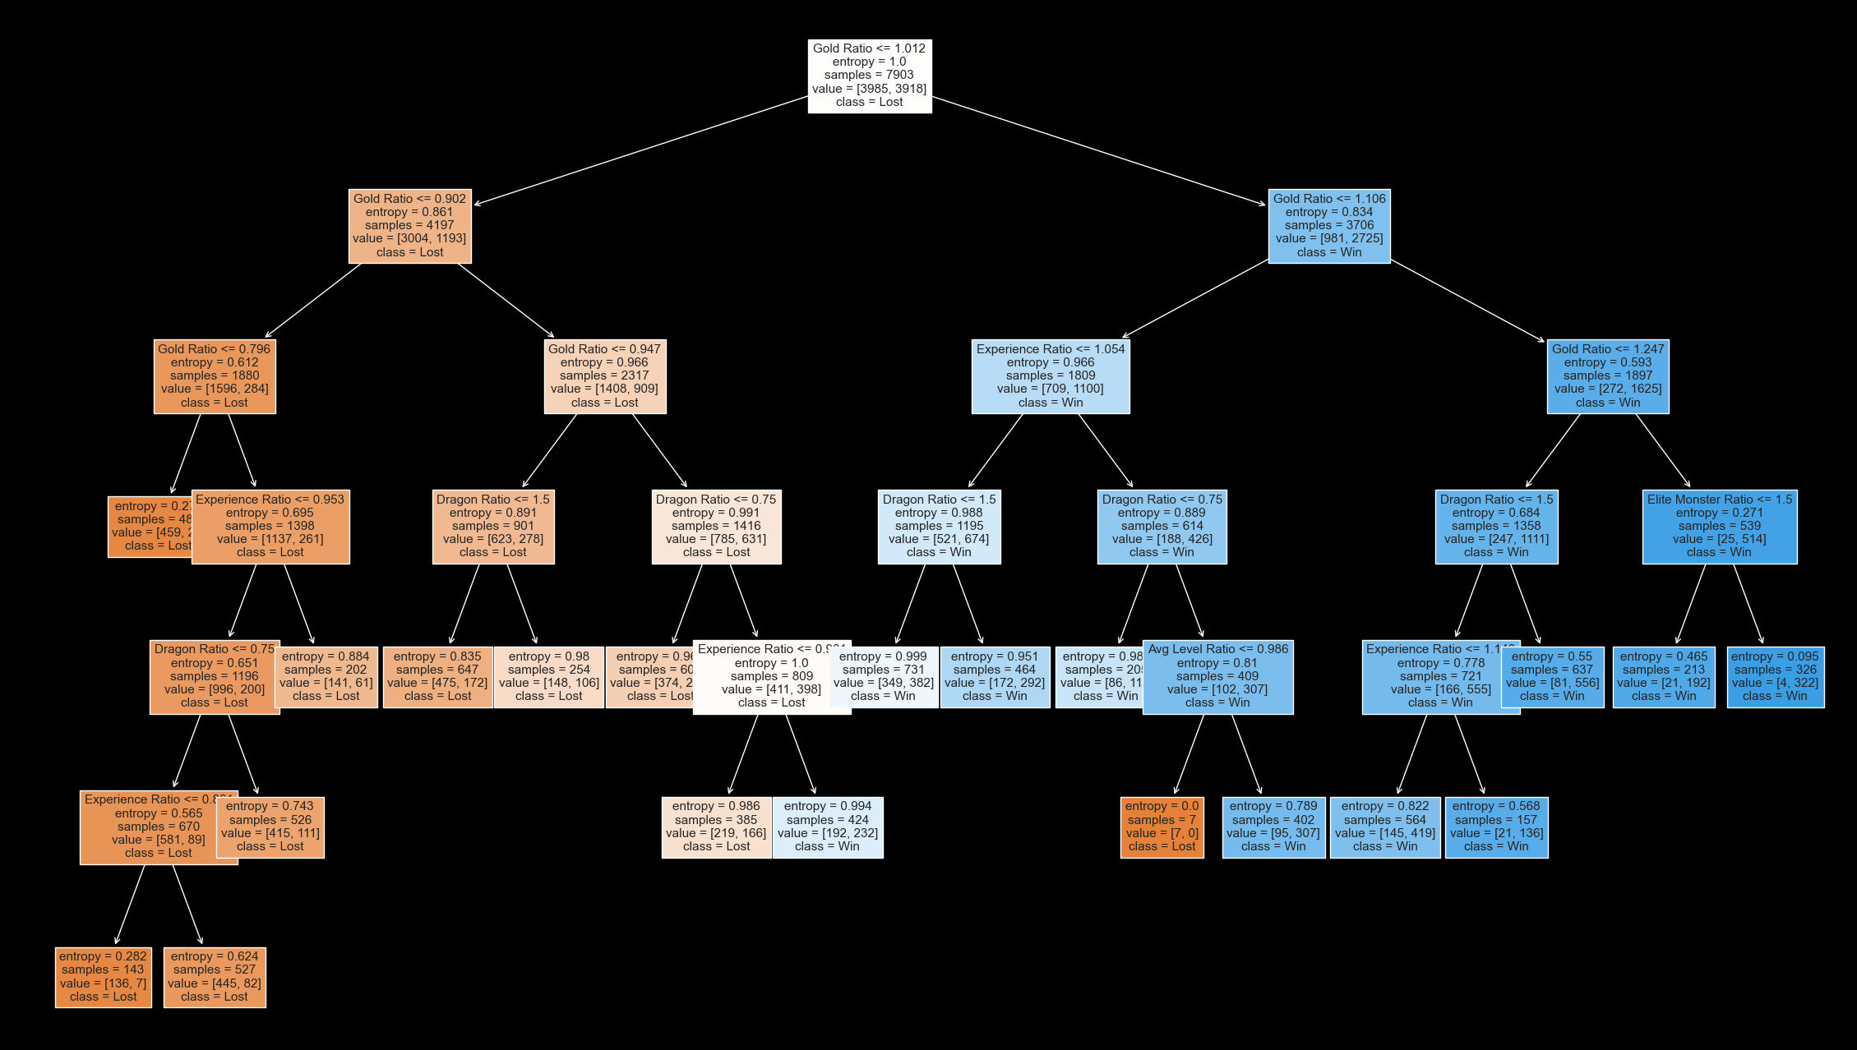

Visualization of Decision Tree Classification Model (Blue Team Perspective)
CHAMPION

Slide 18
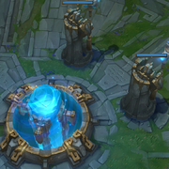
Conclusion: Strategy
Key Insights gained from analysis revealed 3 key performance indicators:
Acquiring more Gold than opponent is one of the strongest factors to winning.
Achieving higher Avg. Levels than opponent increases probability of winning.
More Monster and Minion kills than opponent at beginning of the game increases the odds of winning
Achieving all 3 of the above indicators within the first 10 minutes of a game will greatly secure a match win.
Success Achieved:
With all models achieving greater than a 70% accuracy at predicting League of Legend match outcomes between Diamond and Master player team stats at the 10 minute mark of a match.
NEXUS

Slide 19
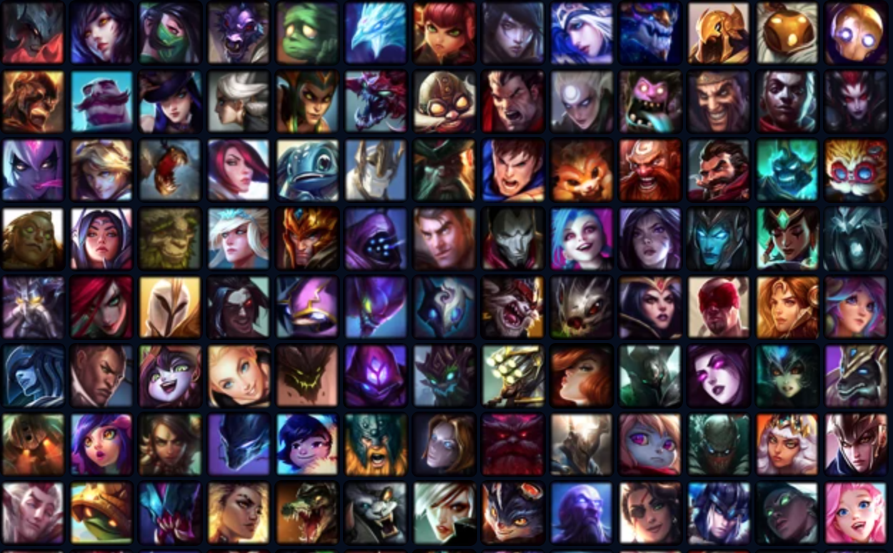
QUESTIONS?
LEAGUE OF LEGEND CHAMPIONS

